Slide 1


DEPARTMENT BES-1
  Course: Data Structures using Python
Course code: 24sc1204
    Topic: Algorithmic Analysis
Session-02

Slide 2



AIM OF THE SESSION
To familiarize students with algorithmic analysis to evaluate time complexities.
INSTRUCTIONAL OBJECTIVES
This Session is designed to:
Analyse the algorithm to run time complexity.
Analyze the time and space complexities of algorithms
LEARNING OUTCOMES
At the end of this session, you should be able to:
Evaluate the time complexities of the different Algorithmic solutions for various types of Problems.
Write the notations for calculating the running time complexity of different algorithms

Slide 3
ALGORITHM ANALYSIS
ASYMPTOTIC NOTATIONS
The performance of an algorithm can change with a change in the input size
Asymptotic Notations can describe an algorithm's run time when the input tends toward a specific or limiting value.
Asymptotic analysis helps to analyze the algorithm performance change in the order of input size.
Usually, the analysis of an algorithm used for calculating the running time complexity of an algorithm is done based on three Asymptotic Notations:
    Best Case (Omega Notation (Ω))
    Average Case (Theta Notation (Θ))
    Worst Case (Big-O Notation(O))

Slide 4
OMEGA NOTATION (Ω)
It basically describes the best-case scenario which is opposite to the big O notation.
It is the formal way to represent the lower bound of an algorithm's running time. It measures the best amount of time an algorithm can possibly take to complete or the best-case time complexity.
It determines what is the fastest time that an algorithm can run.
Follow the steps below to calculate Ω for a program:
  Break the program into smaller segments.
  Find the number of operations performed for each segment(in terms of the input size) assuming the given input is such that the program takes the least amount of time.
  Add up all the operations and simplify it, let’s say it is f(n).
  Remove all the constants and choose the term having the least order or any other function which is always less than f(n) when n tends to infinity, let say it is g(n) then, Omega (Ω) of f(n) is Ω(g(n)).

Slide 5
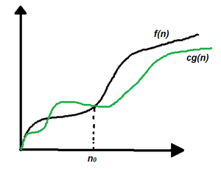
OMEGA NOTATION (Ω)
Mathematical Representation of Omega notation:
Omega (Ω) notation specifies the asymptotic lower bound for a function f(n). For a given function g(n), Ω(g(n)) is denoted by:
Ω (g(n)) = {f(n): there exist positive constants c and n0 such that 0 ≤ c*g(n) ≤ f(n) for all n ≥ n0}.
This means that, f(n) = Ω(g(n)), If there are positive constants n0 and c such that, to the right of n0 the f(n) always lies on or above c*g(n).

Slide 6
THETA NOTATION (Θ)
The theta notation mainly describes the average case scenarios.
It represents the realistic time complexity of an algorithm.
Every time, an algorithm does not perform worst or best, in real-world problems, algorithms mainly fluctuate between the worst-case and best-case, and this gives us the average case of the algorithm.
Follow the steps below to calculate Θ for a program:
  Break the program into smaller segments.
  Find all types of inputs and calculate the number of operations they take to be executed. Make sure that the input cases are equally distributed.
  Find the sum of all the calculated values and divide the sum by the total number of inputs let say the function of n obtained is g(n) after removing all the constants, then in Θ notation, it’s represented as Θ(g(n)).

Slide 7
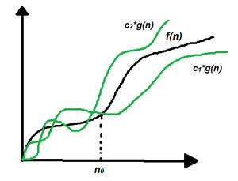
THETA NOTATION (Θ)
Mathematical Representation of Theta notation:
Theta(Θ) notation specifies a bound for a function f(n). For a given function g(n), Θ(g(n)) is denoted by:
Θ (g(n)) = {f(n): there exist positive constants c1, c2 and n0 such that 0 ≤ c1*g(n) ≤ f(n) ≤ c2*g(n) for all n ≥ n0}.
This means that, f(n) = Θ(g(n)), If there are positive constants n0 and c such that, to the right of n0 the f(n) always lies on or above c1*g(n) and below c2*g(n).

Slide 8
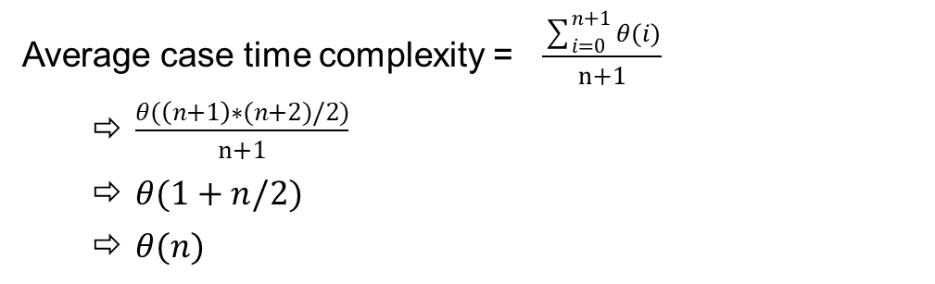
THETA NOTATION (Θ)-Example
Example: In a linear search problem, let’s assume that all the cases are uniformly distributed (including the case when the key is absent in the array). So, sum all the cases when the key is present at positions 1, 2, 3, ……, n and not present, and divide the sum by n + 1.
Since all the types of inputs are considered while calculating the average time complexity, it is one of the best analysis methods for an algorithm.
Average case time complexity = $\frac{\sum_{i=0}^{n+1}{θ(i)}}{n+1}$
  $\frac{θ(\left(n+1\right)∗(n+2)/2)}{n+1}$
  $θ(1+n/2)$
  $θ(n)$

Slide 9
BIG-O NOTATION (O)
Big-O notation represents the upper bound of the running time of an algorithm. Therefore, it gives the worst-case complexity of an algorithm.
  .It is the most widely used notation for Asymptotic analysis.
  .It specifies the upper bound of a function.
  .The maximum time required by an algorithm or the worst-case time complexity.
  .It returns the highest possible output value(big-O) for a given input.
  .Big-Oh(Worst Case) It is defined as the condition that allows an algorithm to complete statement execution in the longest amount of time possible.
Follow the steps below to calculate O for a program:
  Break the program into smaller segments.
  Find the number of operations performed for each segment (in terms of the input size) assuming the given input is such that the program takes the maximum time i.e the worst-case scenario.
  Add up all the operations and simplify it, let’s say it is f(n).
  Remove all the constants and choose the term having the highest order because for n tends to infinity the constants and the lower order terms in f(n) will be insignificant, let say the function is g(n) then, big-O notation is O(g(n)).

Slide 10
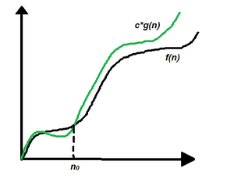
BIG-O NOTATION (O)
Mathematical Representation of Big-O notation:
Big – O (O) notation specifies the asymptotic upper bound for a function f(n).
For a given function g(n), O(g(n)) is denoted by:
O (g(n)) = {f(n): there exist positive constants c and n0 such that f(n) ≤ c*g(n) for all n ≥ n0}.
This means that, f(n) = O(g(n)), If there are positive constants n0 and c such that, to the right of n0 the f(n) always lies on or below c*g(n).

Slide 11
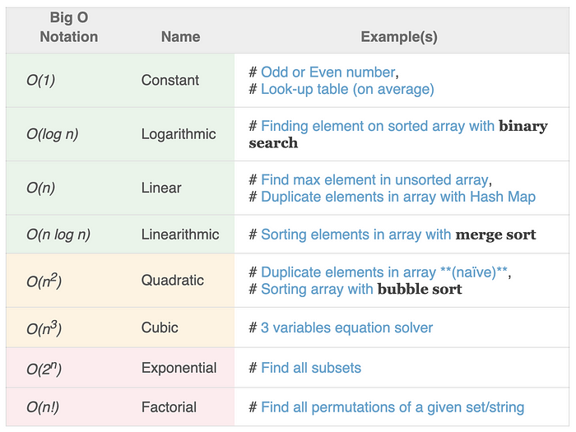
COMMON TIME COMPLEXITIES

Slide 12
TIME COMPLEXITY - EXAMPLES
Examples :
Odd or even number
Accessing an element of an array
CODE SNIPPET
If (n %2 ==0)
print(“Even”)
else
print(“Odd”)
CODE | STEP COUNT
If (n %2 ==0) | 1
print(“Even”) | 1
else | 1
print(“Odd”) | 1
TOTAL COST | 4
High coefficient should be considered , others ignored
Time complexity : O(1) , as it takes constant time

Slide 13
TIME COMPLEXITY - EXAMPLES
Examples :
Traversing an Array, Linked List.
Linear search
CODE SNIPPET
for i in range(0, n)
s=s+i
CODE | STEP COUNT
for i in range(0, n) | n+1
s=s+i | n
TOTAL COST | 2n+1
High coefficient should be considered , others ignored
Time complexity : O(n)

Slide 14
TIME COMPLEXITY - EXAMPLES
Examples :
Traversing an 2D Array.(Matrix Multiplication)
Bubble Sort.
Insertion sort.
CODE SNIPPET
for i in range(0, n):
for j in range(0, n):
print(i,j)
CODE | STEP COUNT
for i in range(0, n): | n+1
for j in range(0, n): | n(n)
print(i,j) | n
TOTAL COST | n²+2n+1
High coefficient should be considered , others ignored
Time complexity : O(n²)

Slide 15
Examples
1) What is the time complexity of the following code:
a = 0;
for i in range(0, N):
for j in range(N, -1, -1):
a = a + i + j;
Explanation:
The above code runs total no of times
= N + (N – 1) + (N – 2) + … 1 + 0
= N * (N + 1) / 2
= 1/2 * N^2 + 1/2 * N
O(N^2) times.

Slide 16
Example
def linear_search(data, value):
for index in range(len(data)):
if value == data[index]:
return index
if __name__ == '__main__':
data = [1, 2, 9, 8, 3, 4, 7, 6, 5]
print(linear_search(data, 7))
Ans: O(n)

Slide 17
SUMMARY
Introduction about the Algorithm and Data Structure
Calculation of the Time and Space complexity of an algorithm to find out its efficiency
Asymptotic Notations are of three types
  Big-O Notation ()
  Theta Notation ()
  Omega Notations ()
Mathematical representations of the above notations
Example for each Notation

Slide 18
SELF-ASSESSMENT QUESTIONS
1. If an algorithm has a time complexity of O(n2)O(n^2)O(n2), what can be said about its behavior as nnn approaches infinity?
A) It grows at a constant rate.
B) It grows exponentially.
C) It grows linearly.
D) It grows quadratically.
2.Which one of the following asymptotic notation is used to provide lower bound constraint?
a) X
b) Ω
c) Θ
d) Ο

Slide 19
TERMINAL QUESTIONS
How is time complexity measured?
Ans: By counting the number of primitive operations performed by the algorithm on a given input size.
2. Which of the following best describes the useful criterion for comparing the efficiency of algorithms?
Ans: Time and Space
3. What does it mean to say that an algorithm X is asymptotically more efficient than Y?
Ans: X will always be a better choice for large inputs
4. Describe the various types of Asymptotic Notations with examples?
What is the worst ,best and average case time complexities of binary search?
Ans: Best O(n), Average and Worst O(n²)
2. What is the importance of time complexity?
Ans:The time complexity of an algorithm determines how long it will take to execute it. The higher the time complexity, the longer it will take for that algorithm to finish running.

Slide 20
REFERENCES FOR FURTHER LEARNING OF THE SESSION
Reference Books:
Sites and Web links:
  https://docs.python.org/3/tutorial/datastructures.html
  https://www.w3schools.com/dsa/dsa_intro.php
  https://www.geeksforgeeks.org/python-data-structures/
  https://onlinecourses.nptel.ac.in/noc25_cs59/preview
  https://www.coursera.org/learn/python-data
  https://www.codecademy.com/learn/learn-data-structures-and-algorithms-with-python
Data Structures and Algorithm Analysis in PYTHON, 2010, Mark Allen Weiss, Second Edition, Pearson Education.
Data Structures and Algorithms, A.V.Aho, J.E.Hopcroft, and J.D.Ullman, Pearson Education, First Edition Reprint2003.
Advanced Guide to Python 3 Programming, John Hunt, 4th Edition, Springer Nature Switzerland AG 2019.
Python Basics: A Practice Introduction to Python 3, David Amos, Dan Bader, Joanna Jablonski, Fletcher Heisler, 4th edition, Real Python.

Slide 21
THANK YOU
Team – Data Structures using Python

